Slide 1
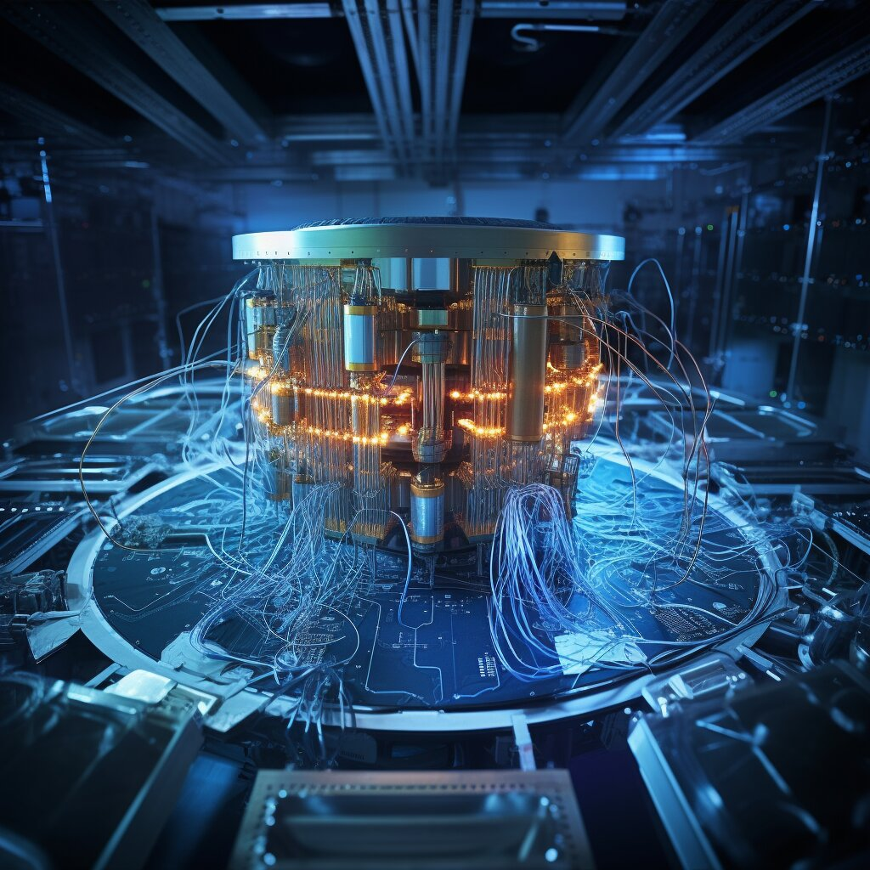
Quantum Computing A New Realistic Paradigm
Prashant CISSP, CCSP, AZURE, CTMA, CSOCP, GCIH
Senior Cyber Security Advisor
https://www.linkedin.com/in/prashantprofile/
Twitter: @prashant_geek
GitHub: https://github.com/prashant-iiitm/Conference-Talks
Disclaimer: Views, thoughts, and opinions expressed in the talk belong solely to the author(s), and not necessarily to the author's employer, organization or any committee.

Slide 2
Agenda
Introduction to Quantum Computing
Problem Domains: Quantum Computing Benefits
Business Applications
Quantum Computing in Canada/Alberta
Silicon Valley Giants take on Quantum Computing

Slide 3
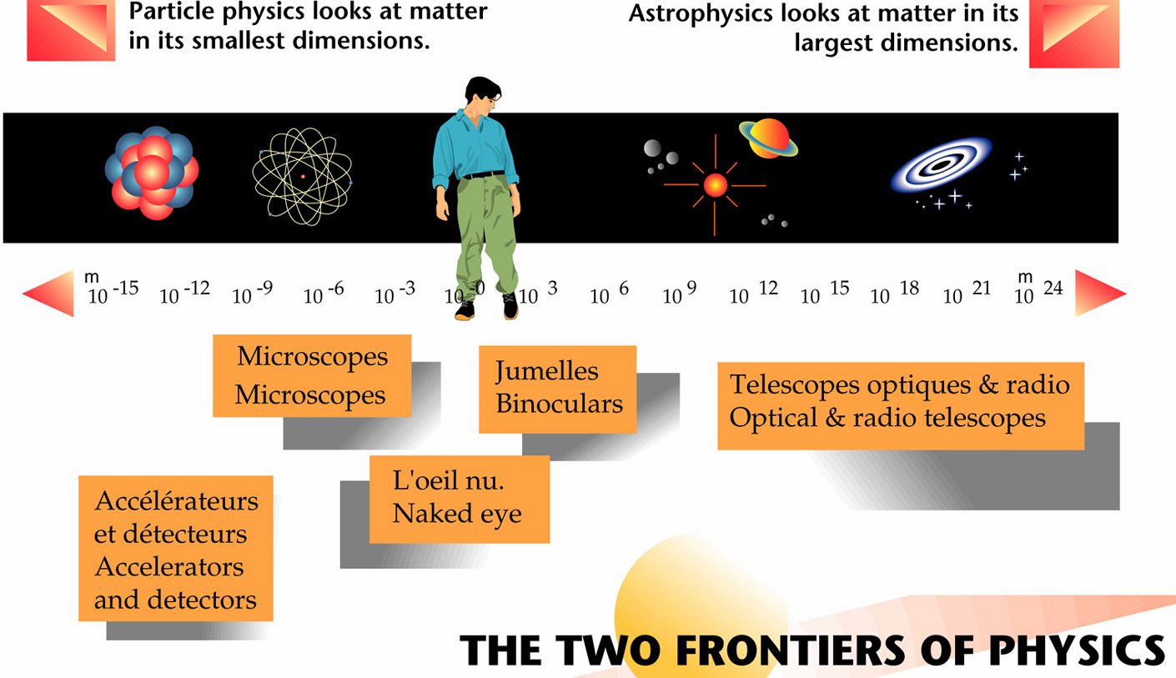
Building Blocks of Matter- Particles

Slide 4
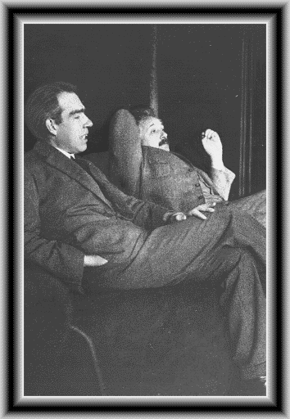

God does not play dice with the Universe!!
Everything we call real is made of things that cannot be regarded as real. Niels Bohr.
If [quantum theory] is correct, it signifies the end of physics as a science. Albert Einstein.
Notes:
https://bit.ly/3lrn3U5

Slide 5
Fundamentals of Quantum Mechanics?
It is a complete physical theory in its own right.
Applications software
Operating system
Specific rules
Quantum mechanics
Quantum
electrodynamics (QED))
QM consists of four mathematical postulates which lay the
ground rules for our description of the world.
Newtonian gravitation
Newton’s laws of motion

Slide 6
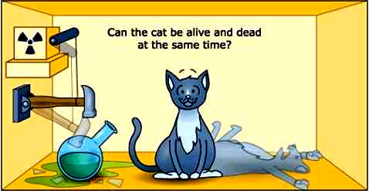
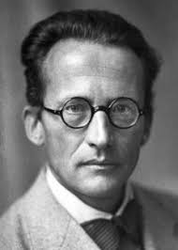
Schrodinger’s CAT paradox!! (Superposition Principle)
If you are not completely confused by QM, you do not understand it. John Wheeler
Notes:
https://bit.ly/3Af67GM

Slide 7

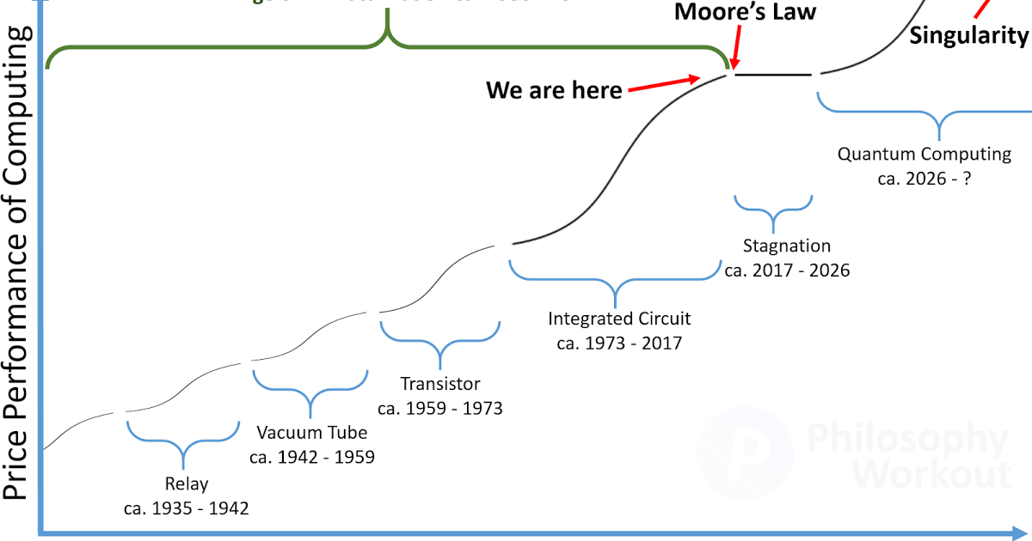
Physics meet Computing Sciences - Moore’s Law
Notes:
https://bit.ly/3tIBO8X

Slide 8
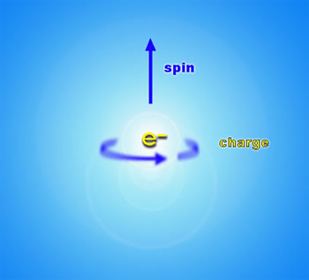
Quantum Mechanics version of Information - Quantum Informatics
The basis of information theory is discrete mathematics: binary digits.
Quantum information employs quantum states as basic elements of information.
Examples of quantum bits (qubits) are nuclear spin, motion of trapped ions, photons in optical resonators: each offers a future technology for future quantum information processing.
Notes:
https://bit.ly/3hETs8O

Slide 9





Business Applications
Optimization
Machine Learning
Simulation
Cybersecurity
Notes:
In the oil and gas industry, the units could prove highly valuable to reduce operational costs and risks, run powerful simulations, and help curbing emissions.
Among players embracing quantum processing to date are ExxonMobil, Total, Shell, and BP, according to GlobalData.
IBM is standing out as provider, but energy firms are also relying on D-Wave, Microsoft, and Atos.

Slide 10
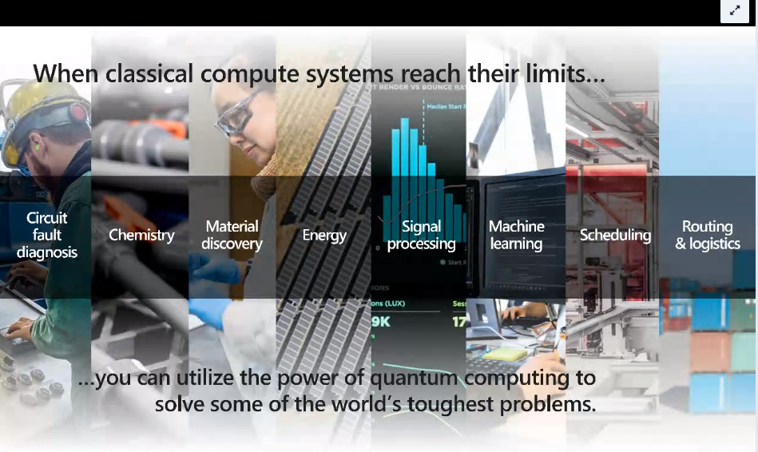
Notes:
15% of energy is lost in classical grids. Matching energy production with forecasting user demand.
Ideal balance of resources versus energy sources e.g carbon emissions
Quantum inspired optimization techniques: logistics and routing.

Slide 11
Problem Domains: Quantum Computing Benefits
Simulations to reduce carbon emissions: ESG
Flow Optimization: optimal routing of commodity flow (liquid, gas)
Scalability of experimentation and dramatic increase in modeling accuracy
Enables order of magnitude faster iterations: scheduling nomination batch jobs
The future market price prediction is an unknown random variable, but profitable trades are possible using an estimate of its probability density function where QC has unique advantage
Large organizations which have footholds in several countries can waste a lot of money trading between currencies sub-optimally. Cross border organizations routinely exchanges vast amounts of USD for CAD and vice versa which can be optimized
Notes:
QC to provide opportunities/threats on Block Chain. Safety of block chain (proof of work)
Financial portfolio optimization: juggling between several asset classes, create a risk return tradeoff for certain set of asset classes shows promising results using QC optimization
Logistics planning, traffic planning, map power optimization (manage roster of people in airport)
Fraudulent credit card transactions: anomaly detection (outlier detection), less false positives.
Quantum machine learning for trading data: training time for qc systems learn with much lesser training data set
Cyber Security: cryptography and post quantum cryptography (breaking factorization-based security systems)
Quantum sensing in Oil and Gas sector. Studying yield from oil reservoirs
Health data: QC can enhance the accuracy of health data.
In the oil and gas industry, the units could prove highly valuable to reduce operational costs and risks, run powerful simulations, and help curbing emissions.
Among players embracing quantum processing to date are ExxonMobil, Total, Shell, and BP, according to GlobalData.
IBM is standing out as provider, but energy firms are also relying on D-Wave, Microsoft, and Atos.

Slide 12
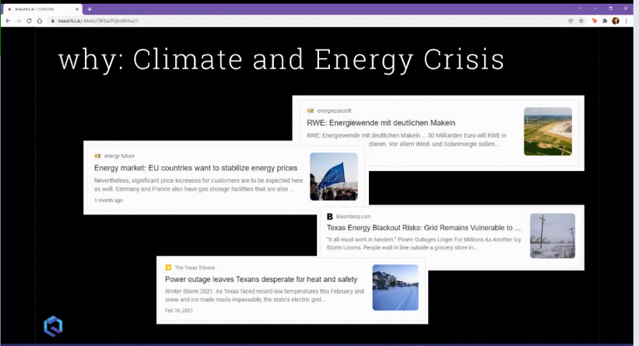
Climate and Energy Crisis: Quantum Computing Application
Notes:
Quantum Computing Opportunities in Renewable Energy and Climate Change
https://qce.quantum.ieee.org/workshops-program/#annaritagiani
https://www.nature.com/articles/s43588-021-00032-z?proof=t

Slide 13

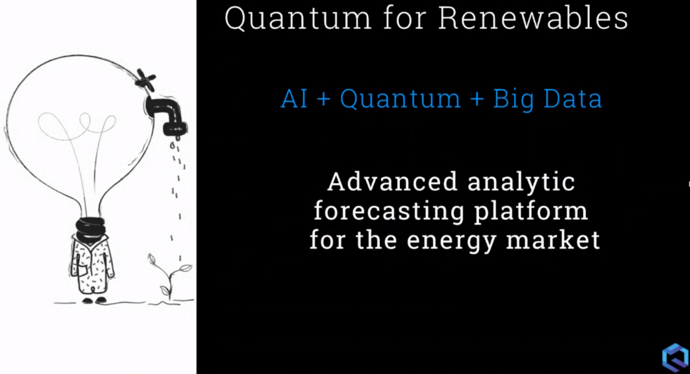
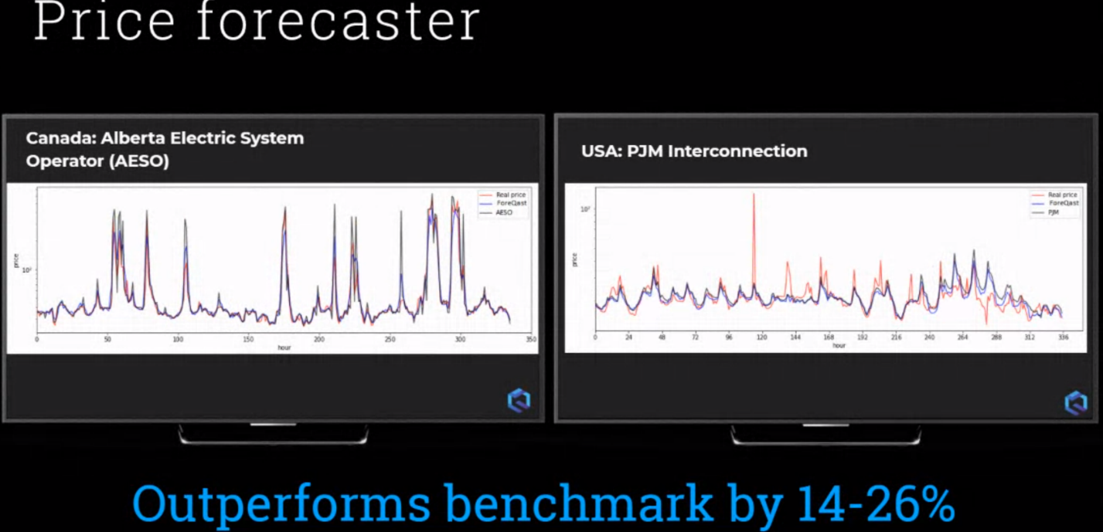
Notes:
Foreqast CEO Chris mentioned they wanted to work on wind farm optimization problems but didn't find any takers who will work with them or pay for it.
chris@foreqast.ai
https://linkedin.com/in/cmaster

Slide 14
Quantum Computing Business Applications
Increased Cost Savings through Pipelines Capacity Optimization
Financial Portfolio Optimization
Logistics Route Planning
Manpower Optimization
Optimization

Slide 15
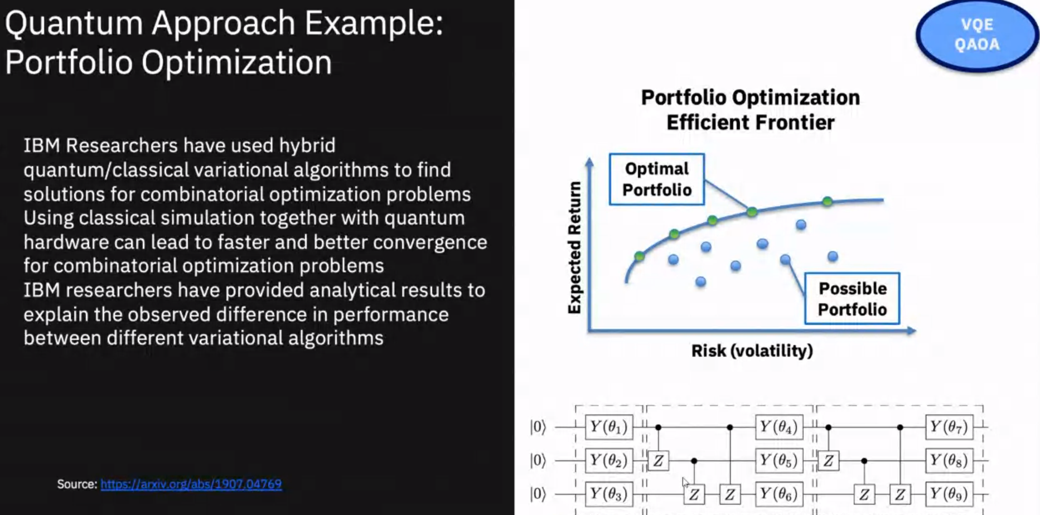

Slide 16
Quantum Computing Business Applications
Market Simulations
Risk Modelling
Increased Revenue through Pipeline Capacity Modelling
Accurate Gas Distribution & Storage Forecasting
Simulation

Slide 17
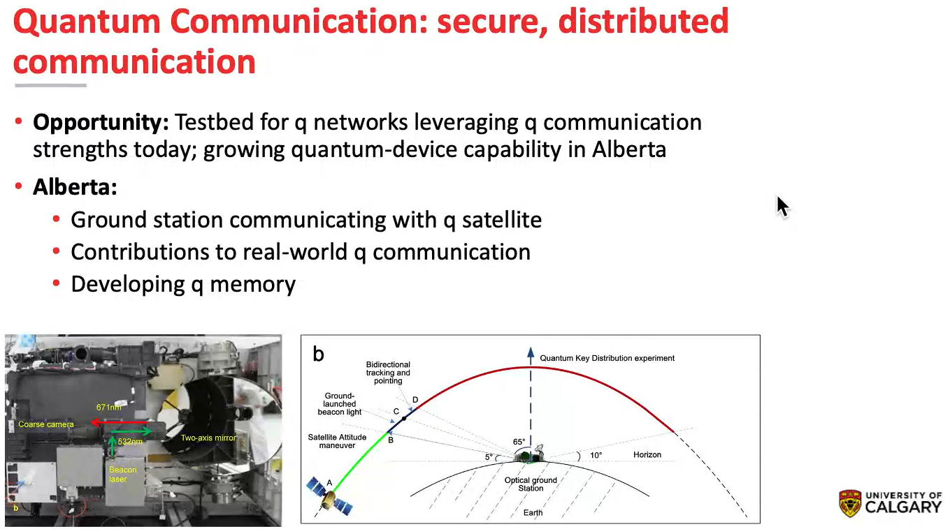

Quantum Computing Business Applications
Cybersecurity
Notes:
Few Kilo Bits of secrete key exchange with Quantum Satellites done as part of Quantum Cloud initiative.

Slide 18
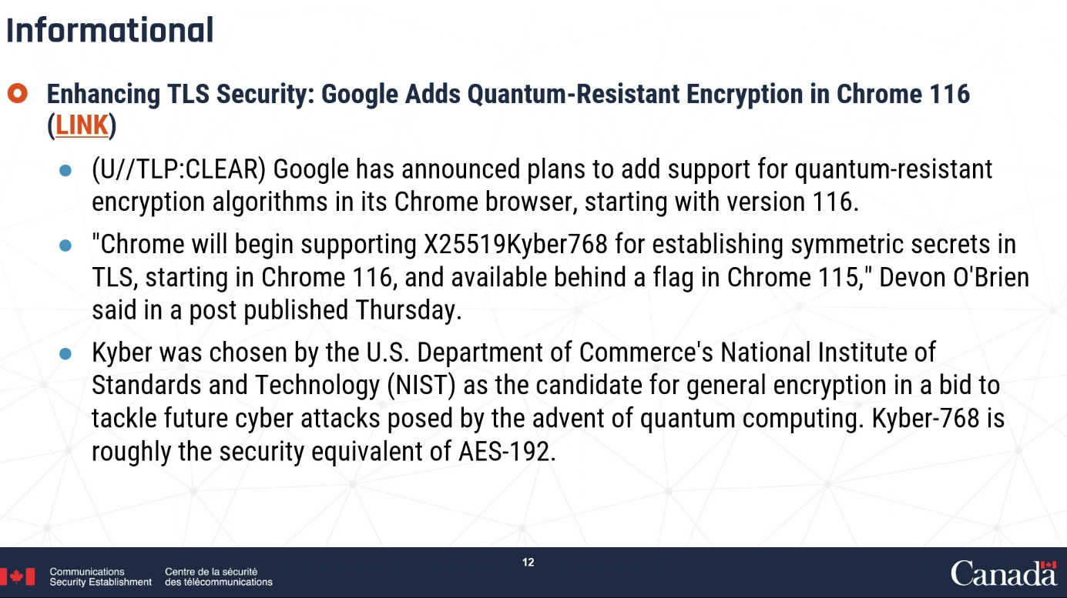
Canadian Center of Cyber Security Update 31st Aug for Energy Sector
Google Chrome 116 Update using Quantum Resistant Cryptography in the browser: https://www.thesslstore.com/blog/googles-post-quantum-cryptography-experiment-successful/
CISA Post Quantum Cryptography Roadmap: https://www.cisa.gov/quantum , https://www.dhs.gov/quantum

Slide 19
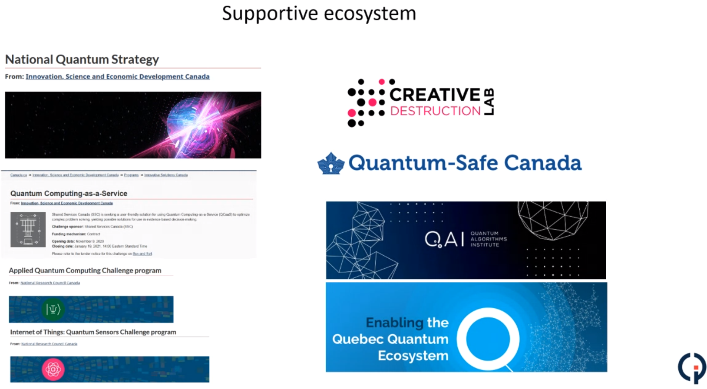

Quantum Computing in Canada/Alberta
Canadian Gas Association is working with Quantum Safe Canada to create guidance and framework documents
that can be used by CGA members to prepare for the risks that quantum computing will pose to cryptography,
cybersecurity and business continuity.
Notes:
Quantum computing is transitioning from scientific research to a quantum technology industry. Much progress is still needed to solve industry relevant problems and achieve quantum advantage. Moving towards quantum computing readiness is now an urgent goal shared across many industry verticals, academic institutions and governments. Hybrid models, algorithms and architectures is now seen as way to overcome the limitations of Noisy Intermediate Scale Quantum (NISQ) devices for near-term quantum computation.

Slide 20
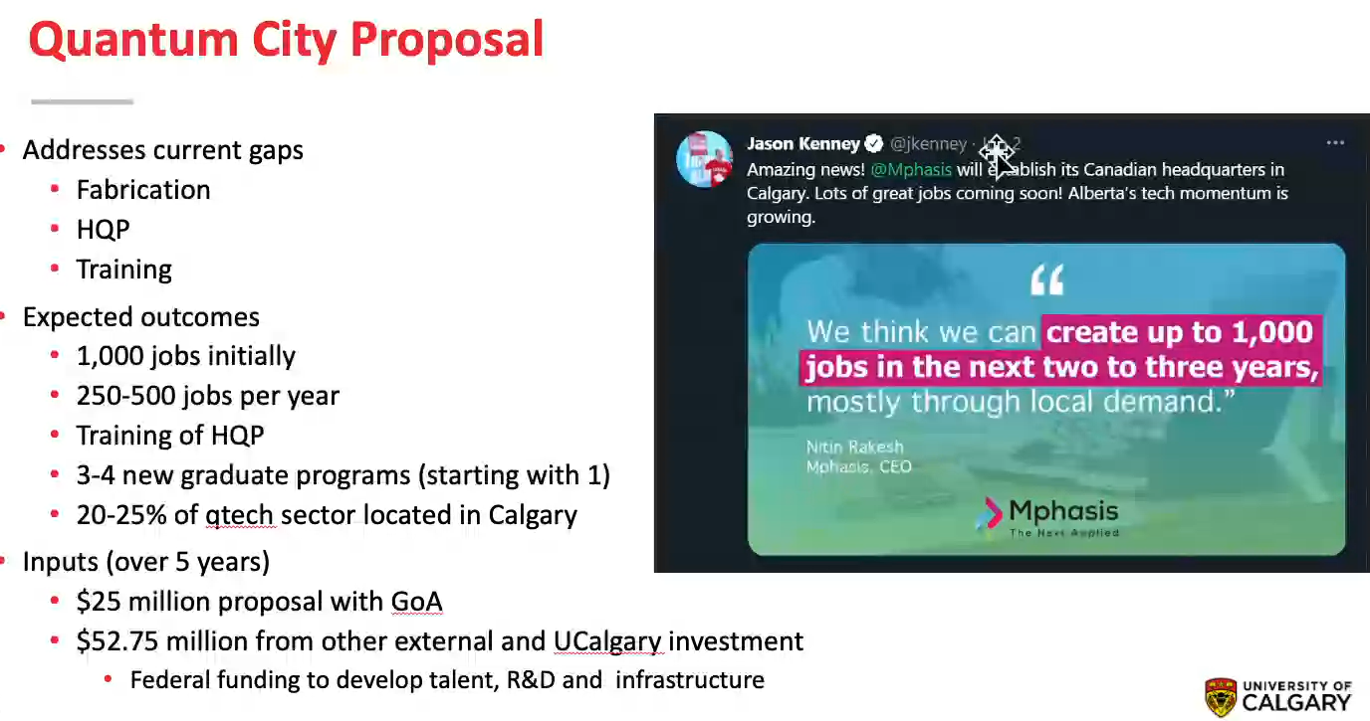
Notes:
Alberta Machine Intelligence Institute for machine learning in Quantum Computing
1QBit: Vancouver based startup
Zapata: Boston based Quantum Computing company with a branch in Toronto
Oil Reservoir Yield Predictions project in place. Reach out to Barry Sanders directly for any opportunities.
Petroleum Engineering/NSERC grant: Fluid dynamic in nature, principles (Darcie's principles). Grid is small and qubits. Trivial well simulation in 1 dimension. Using IBM 1 Qubit Quantum Computer to simulate the yield problems in quantum wells.

Slide 21
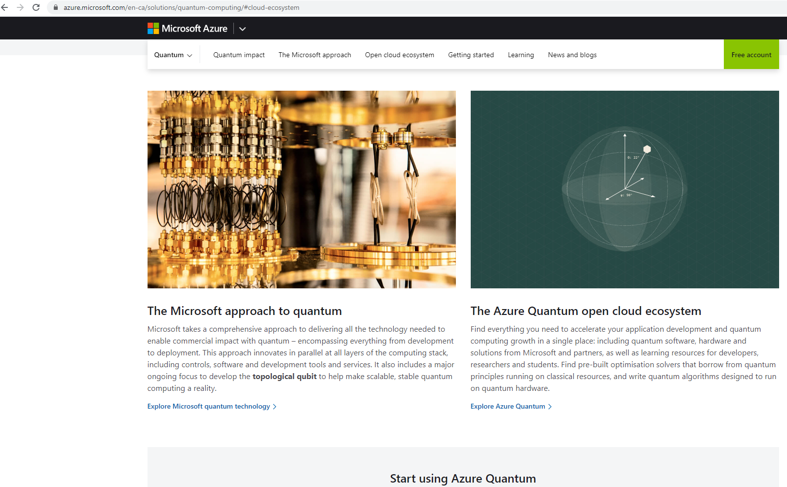
Azure Quantum Open Cloud

Slide 22
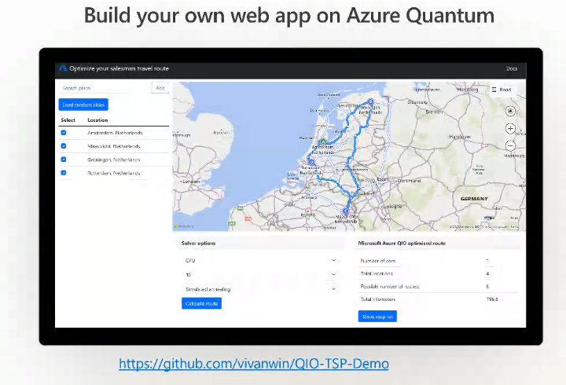
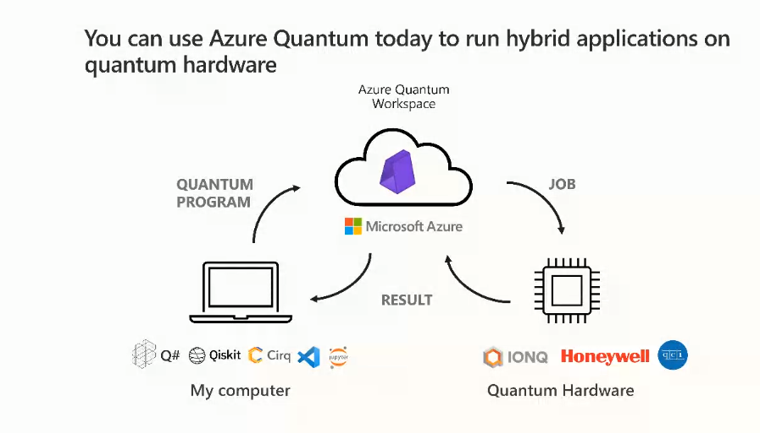

Slide 23
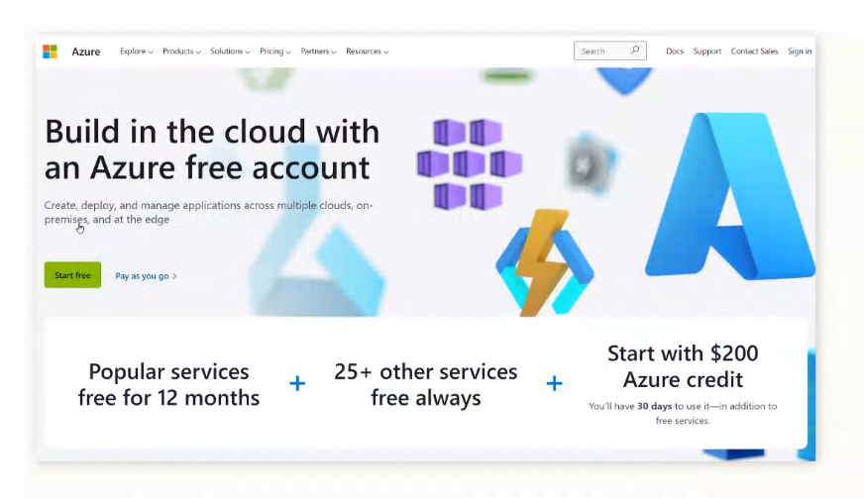
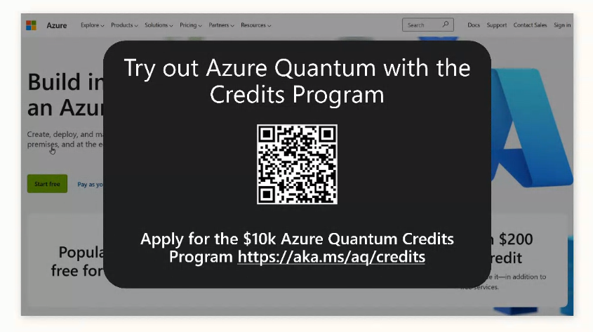
Notes:
https://aka.ms/aq/credits
https://aka.ms/try-quantum-katas
GitHub repos: https://github.com/vivanwin/QIO-TSP-Demo

Slide 24
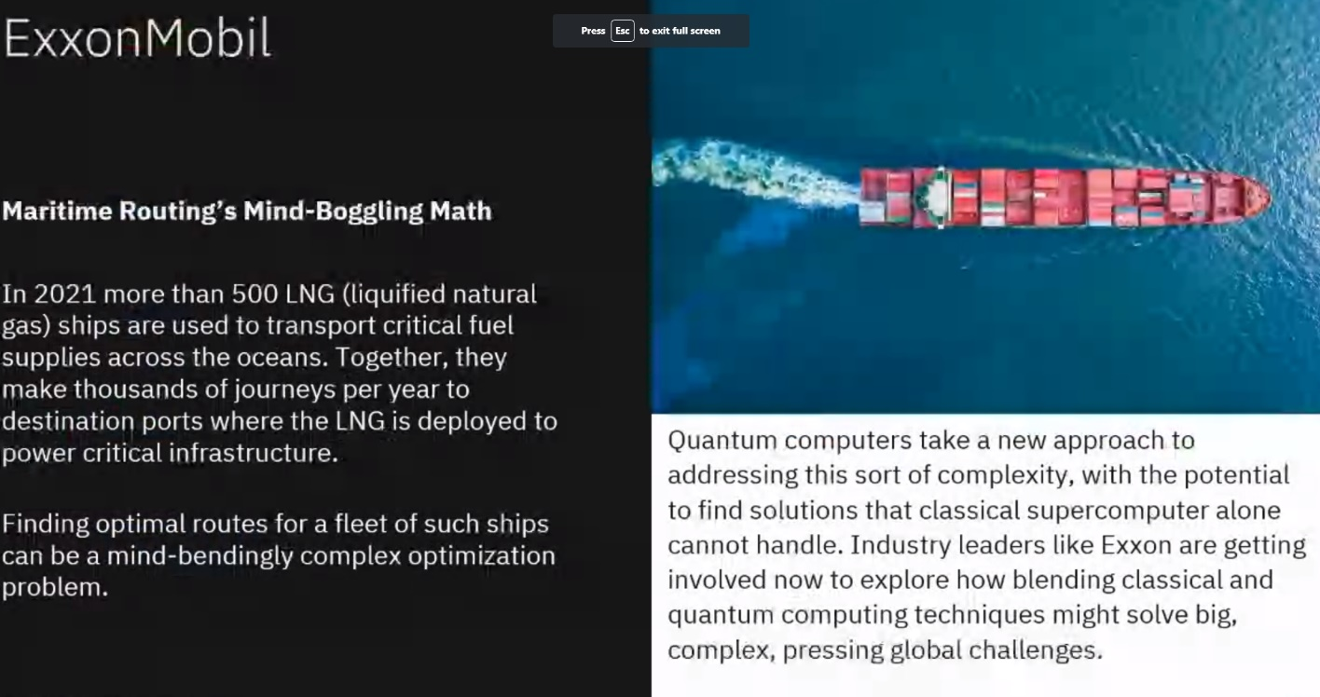
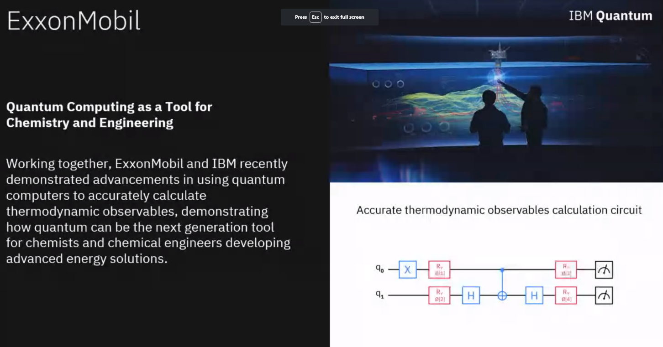
ExxonMobil & IBM: Quantum Computing
Notes:
Formulating and Solving Routing Problems on Quantum Computers | IEEE Journals & Magazine | IEEE Xplore : Routing problem solving using QC (Exxon Mobile problem)

Slide 25
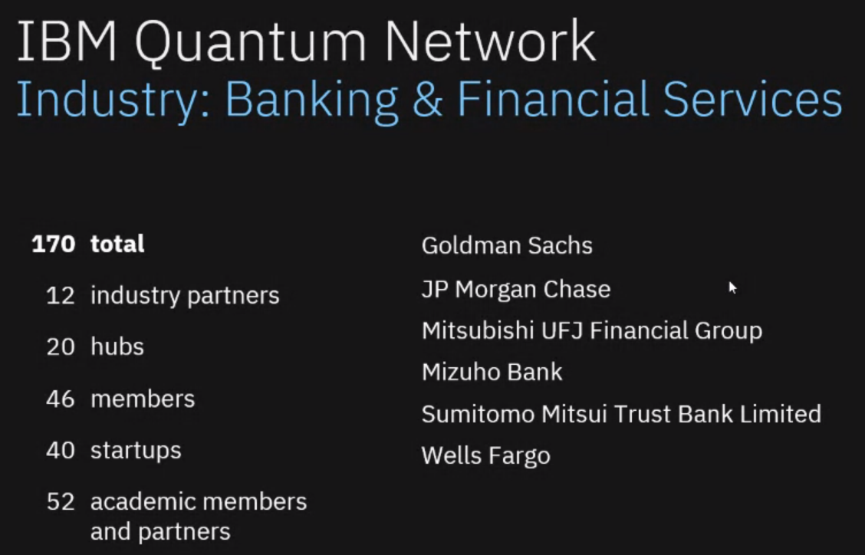
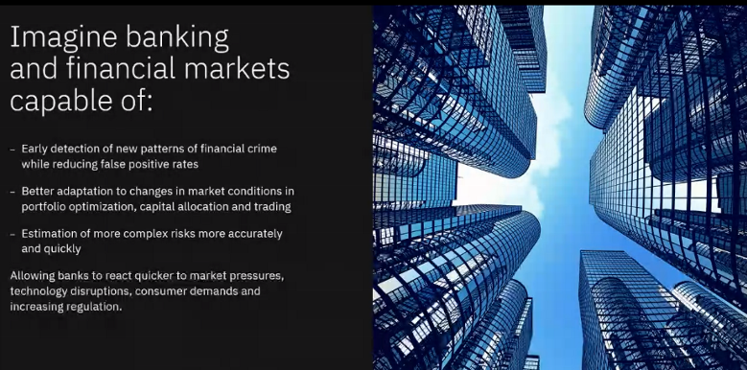
IBM Quantum Network

Slide 26
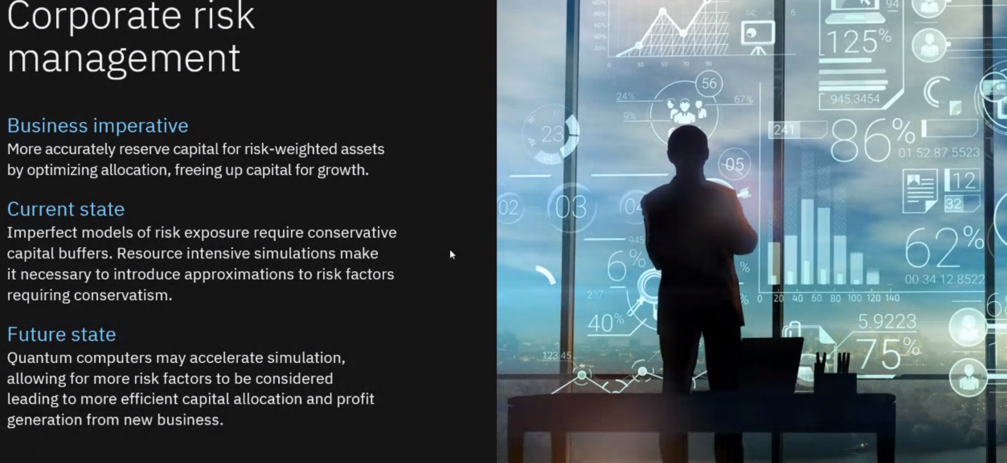
Notes:
https://quantum-journal.org/papers/q-202… A Threshold for Quantum Advantage in Derivative Pricing

Slide 27
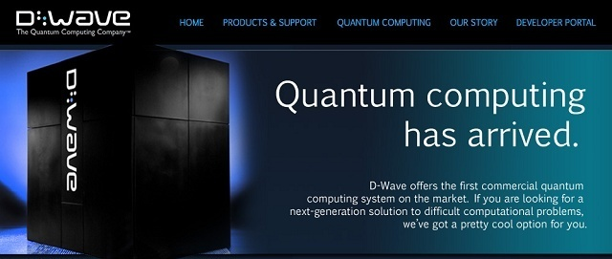
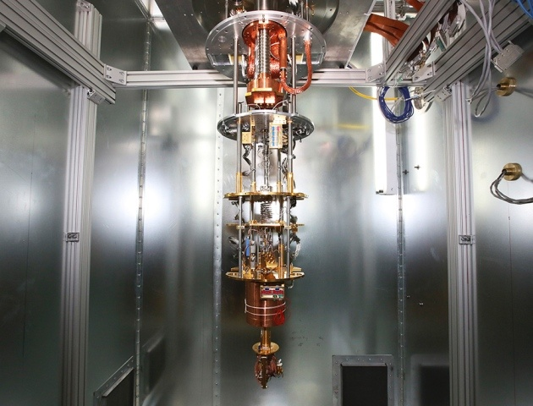
D-WAVE Quantum Computing
Notes:
https://bit.ly/3lL4Ill

Slide 28
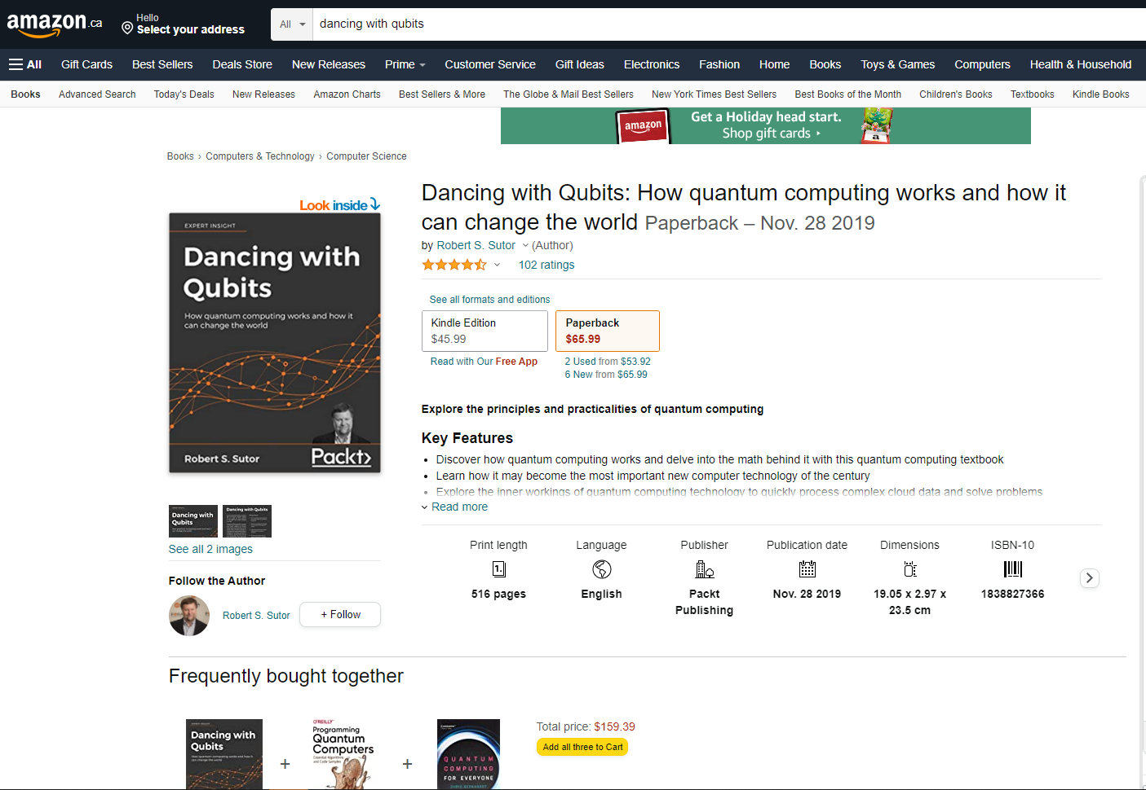
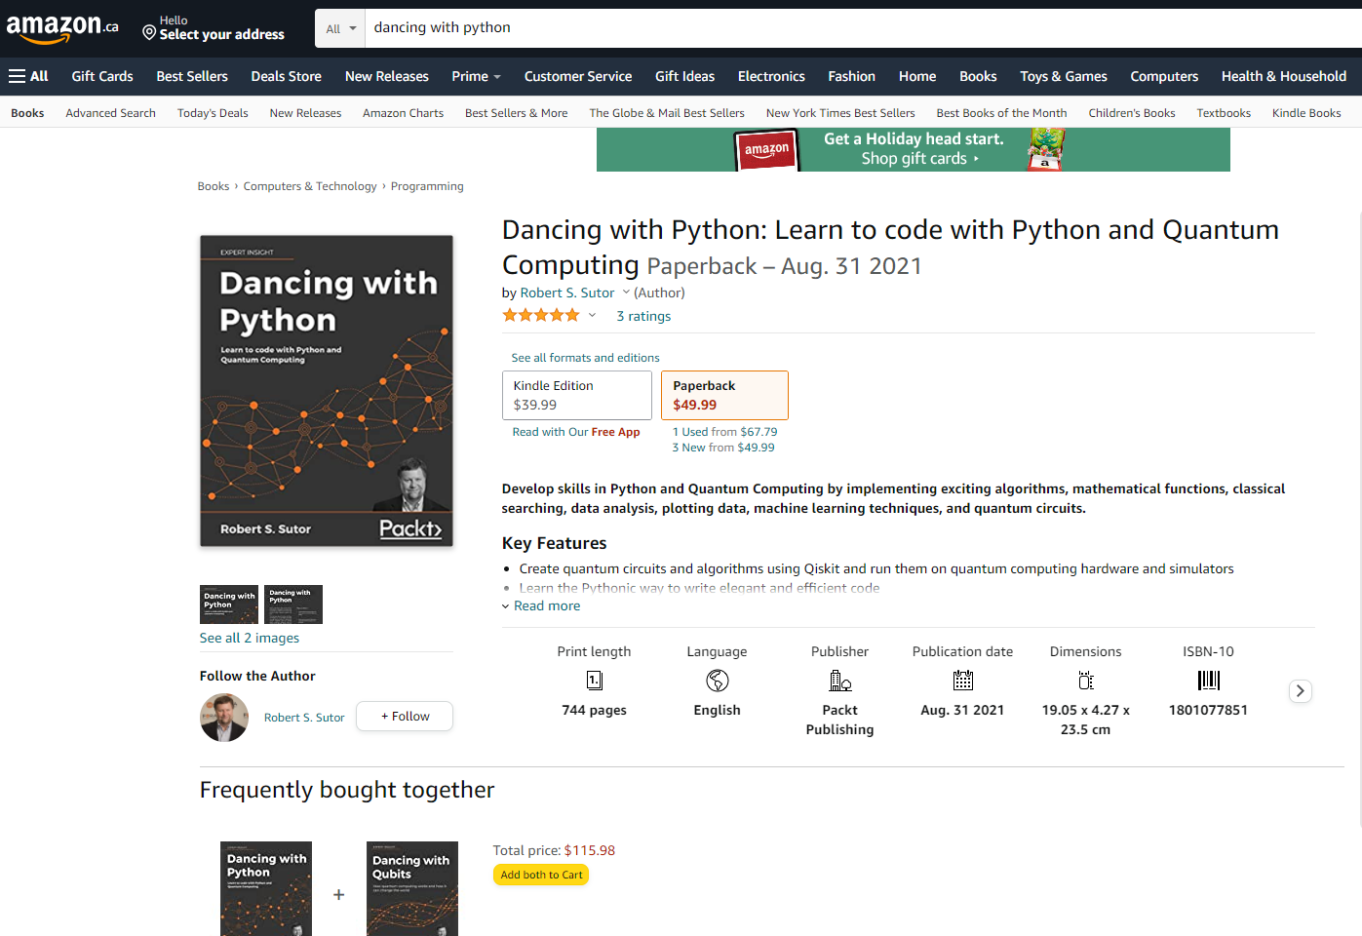
Appendix: Quantum Computing Resources

